Slide 1

Bank Loan Analysis | Finance
Group: 4
Project Team:
Rakshitha C
Pradeep Rasakachula
Deeya Agarwal
Shaik Sadik
Sreeram K
Mohan K Gola

Slide 2
Project Objective
This project involves analyzing bank loans for customers. We were provided with two datasets in .csv format, each containing 39,000 rows. The objective was to analyze the growth of the bank's loan portfolio over the given years.
We utilized MS-Excel and MySQL for analyzing, cleaning, and removing duplicates from the dataset. We then prepared dashboards using Tableau and PowerBI tools, where we conducted calculations, merged data, and created interactive visualizations.

Slide 3





Tools Used
MS EXCEL
Power BI
Tableau
MY SQL

Slide 4
Contents
KPI-1 : Year wise loan amount Stats
KPI-2 : Grade and sub grade wise revol_bal
KPI-3 : Total Payment for Verified Status Vs Total Payment for Non Verified Status
KPI-4 : State wise and month wise loan status
KPI-5 : Home ownership Vs last payment date stats

Slide 5
1. Year wise loan amount :
It is observed that the Loan Amount is increasing year by year.
Starting 2007 loan amount has raised from 22,19,275 to 26,05,06,575 by year 2011.
Loan amount issue has raised more than 90% over the last 4 years
Total loan amount 44,56,02,650 with total loans issued 39171
Year Total Loan Amount
2007 ₹ 22,19,275
2008 ₹ 1,43,90,275
2009 ₹ 4,64,36,325
2010 ₹ 12,20,50,200
2011 ₹ 26,05,06,575
Grand Total ₹ 44,56,02,650

Slide 6
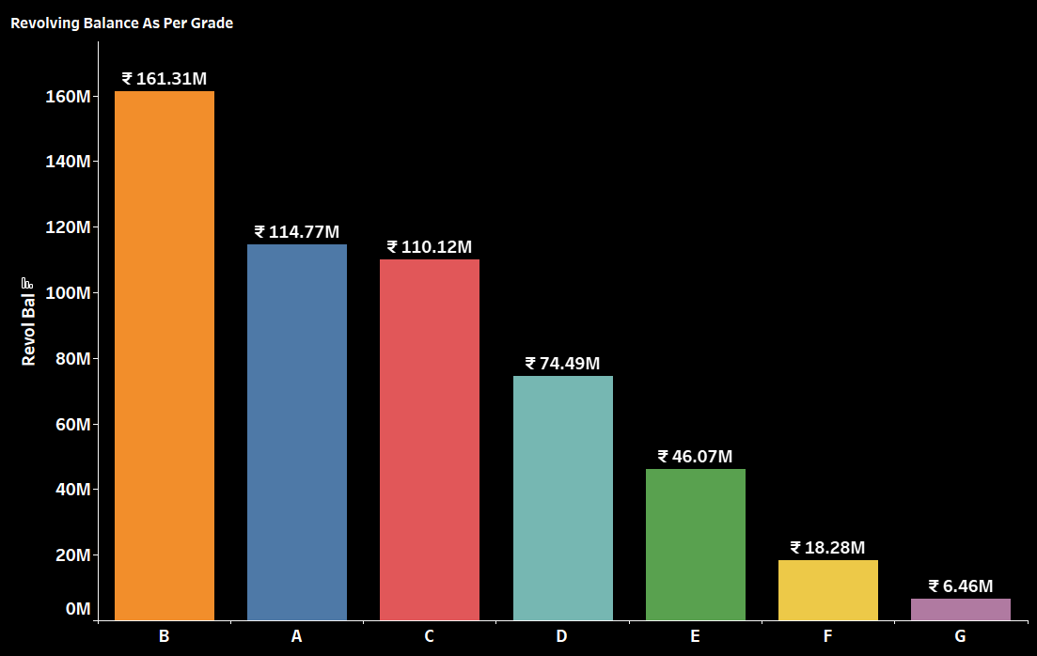
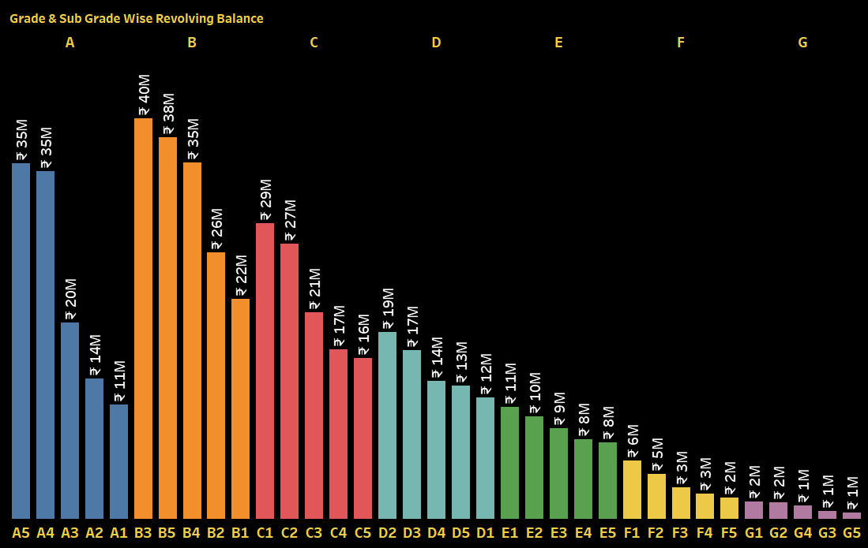
2. Grade and sub grade wise revolving Balance
Comparing Grade and subgrade wise revolving balance we can notice Grade-B have more revolving balance then any other grade & Grade-G have very low revolving balance.
As we can see that Grade B customers has higher annual income for 10+ years of employment period, so higher the annual income lower the Debt to income ratio and hence, more number of customers took loan in Grade B .
Similarly, it goes for other grades too B>A>C>D>E>F>G order for revolving Balance as per annual income

Slide 7
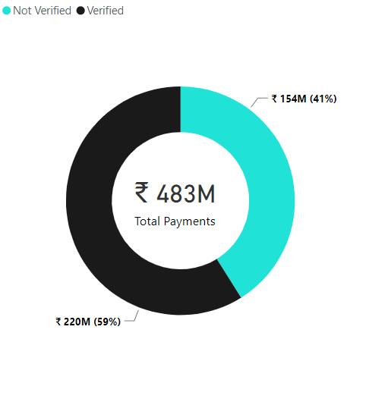
3. Total Payment for Verified Vs Non Verified Status :
This is the first stage of the verification process. The bank needs a loan application to initiate the document collection and verification process
Used Donut chart(since we are using categorical Variables) we can observe that 59 % of loans are verified and 41% are not verified.

Slide 8
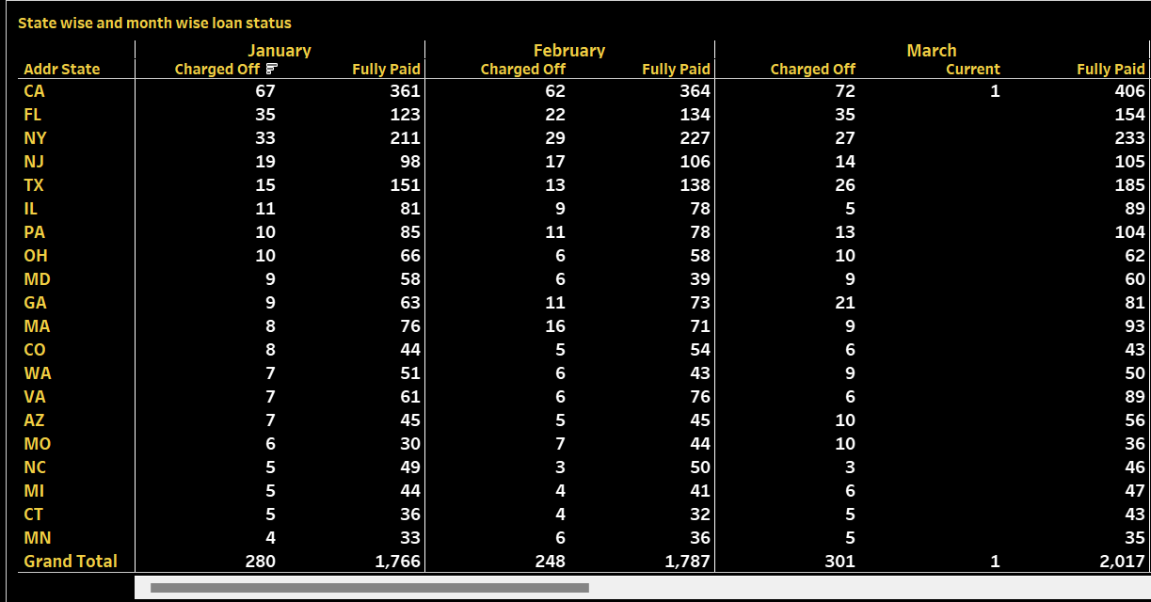
4. State wise and month wise loan status
It is Observed that CA states has more loans which got paid on time followed by FL.
CA state is also higher loans getting charged off.

Slide 9
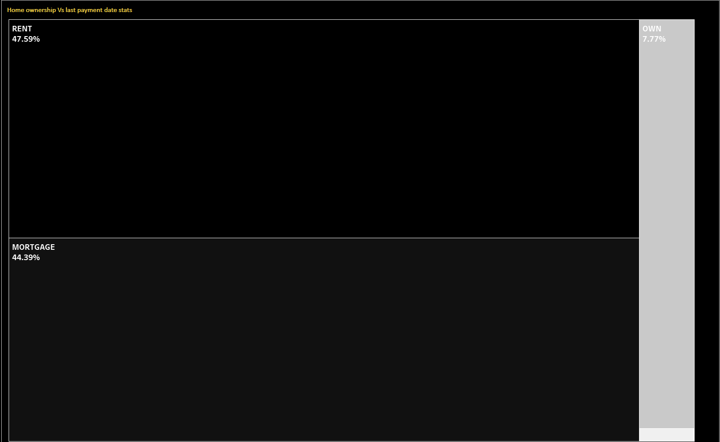
5. Home ownership vs last payment date:
Used Tree maps to see how much % of customers paying debt on last date
Here, we can see that maximum customers who paid on last date was Renters(47.59%) followed by Mortgage(44.39%).
Owners who owned houses are paying loans in time before the due date and its is approximately 7.37% as per info available.

Slide 10
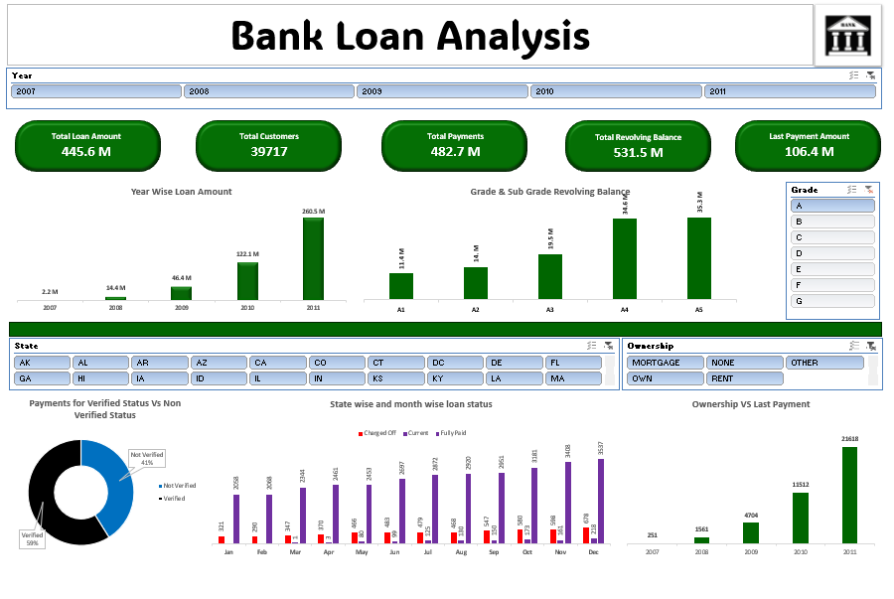
EXCEL DASHBOARD

Slide 11
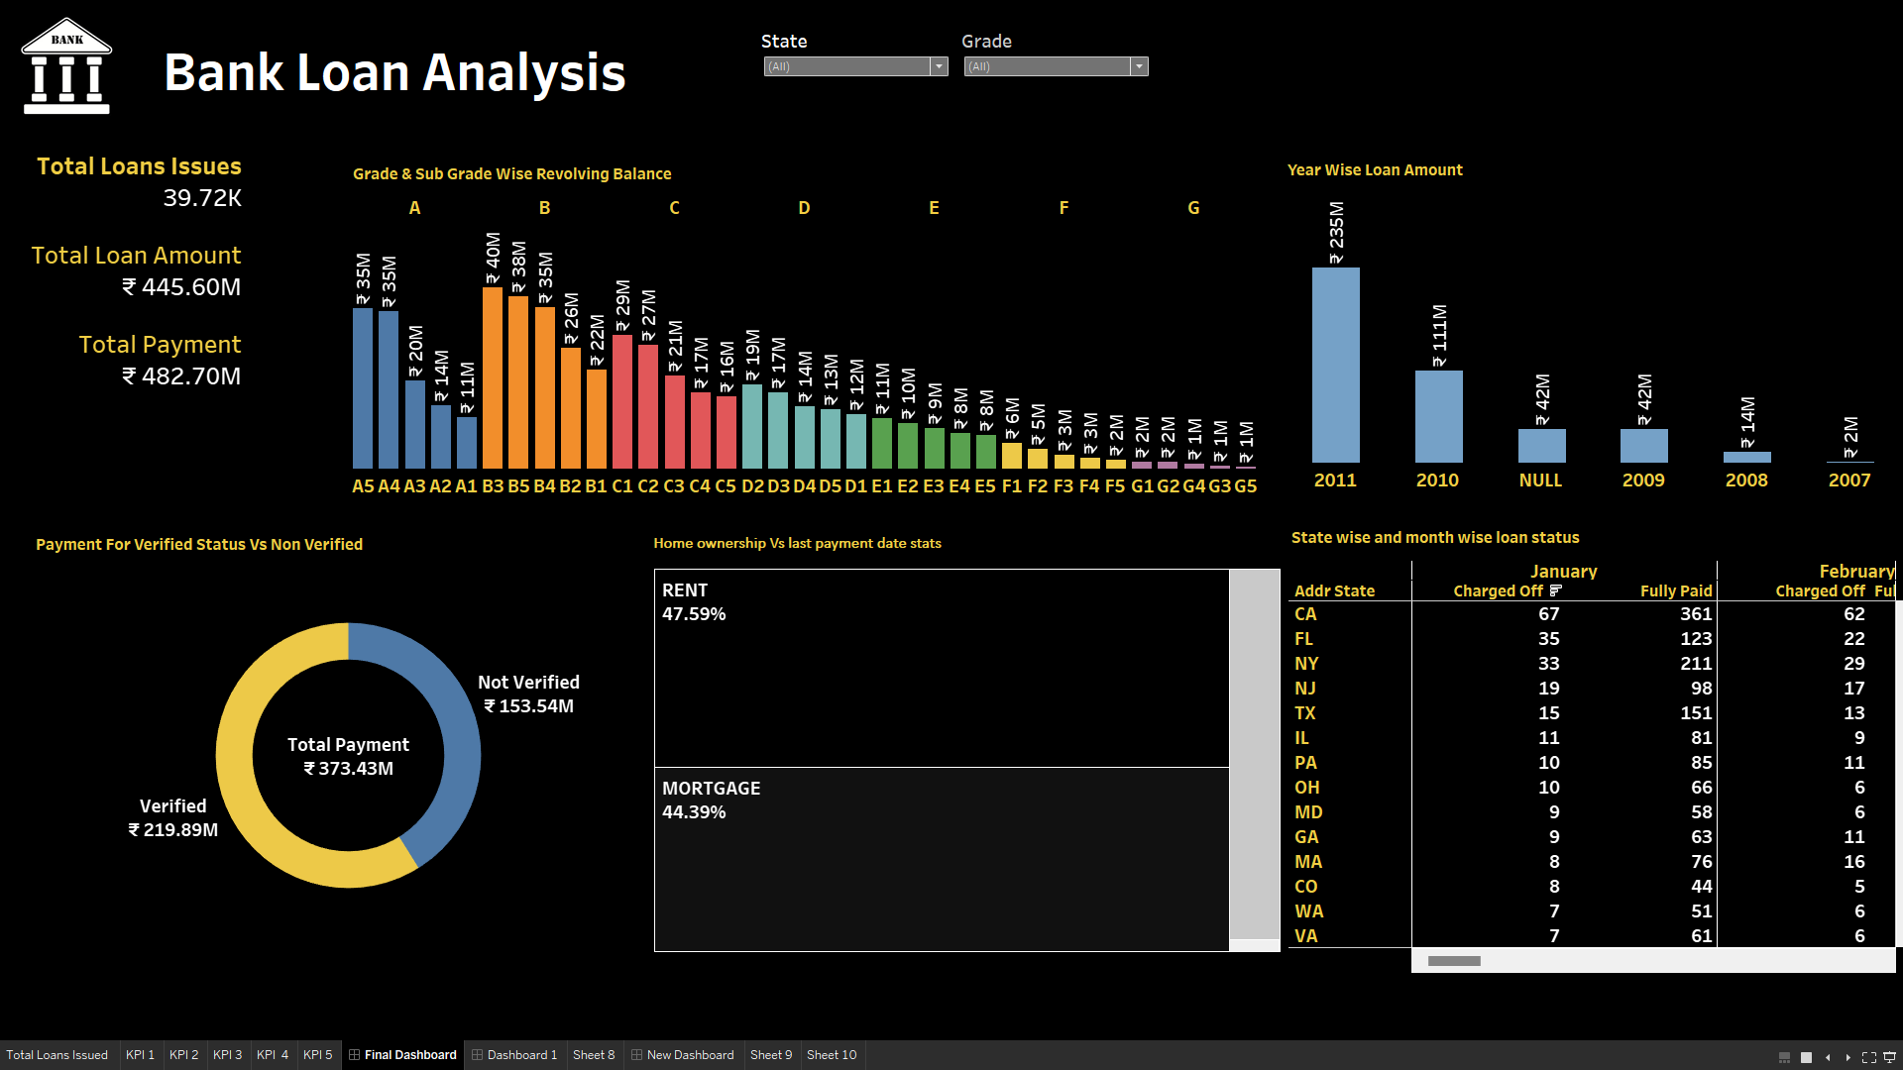
Tableau Dashboard

Slide 12
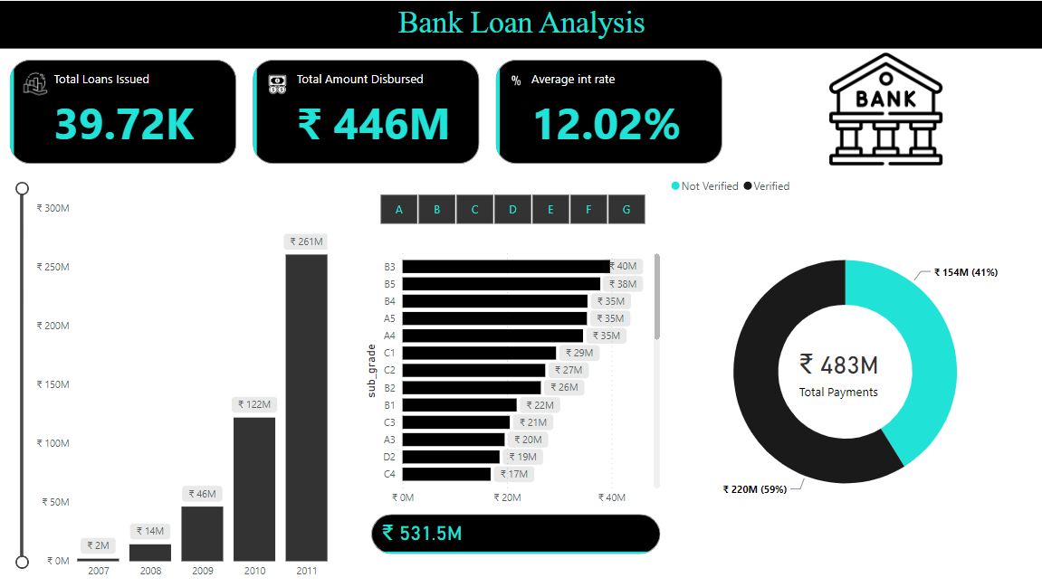
Power Bi Dashboard

Slide 13
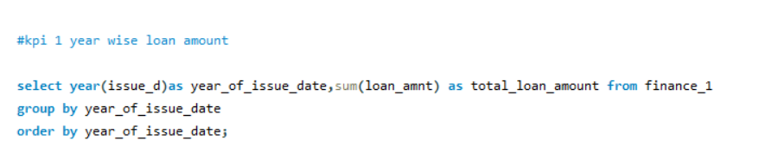
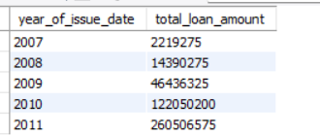
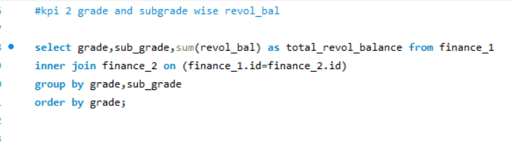
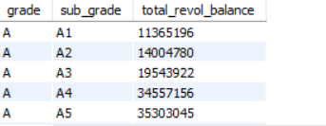
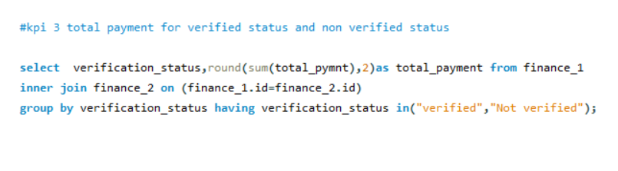

MY SQL WORK BENCH

Slide 14
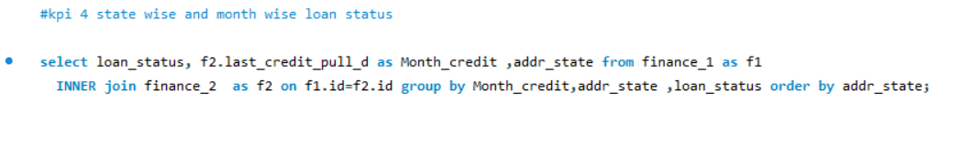
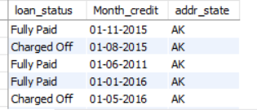
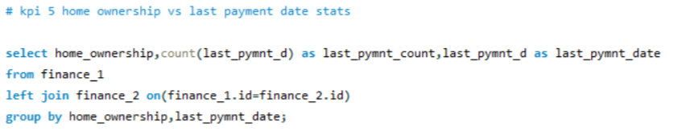
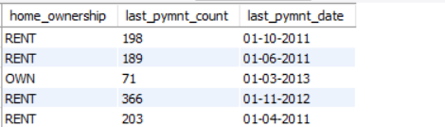

Slide 15
CHALLENGES FACED
Rigorously test to ensure it performs well and delivers accurate insights.
As your data grows beyond, the dashboard should be able to handle the increased load without breaking down.
Pre-aggregate the data before it reaches the dashboard to improve performance.
Ensure your data queries are efficient and only retrieve the necessary information.
Without proper optimization, the data could be slow to load and interact with this can be frustrating for users and defeat the purpose of a quick and informative display.

Slide 16
Outcome of the project:
The implementation of KPIs in Excel, Tableau and Power BI helped to gain proficiency with the application of these business analytics tools.
The group project taught us how to collaborate and work as a team to produce the output more effectively.
The weekly check points helped to plan the project in a better way which allowed to achieve the larger objectives.

Slide 17
Thank You
For Your Attention

